Slide 1

By : Muskan Singhal

Slide 2
PROBLEM STATEMENT
Provide a data-driven solution to predict
whether a customer will
churn or not.

Slide 3
OVERVIEW
The goal of this project is to build a machine learning model that can accurately predict whether the customer will leave the bank or not i.e. Exited or not. In this project, the focus is set on predicting whether a specific customer will continue to use the bank’s services or not. This allows the bank to determine the factors that lead to customers leaving their services for other financial services, and an in-depth analysis can help the financial institutions in retaining the customers.
The dataset provided had 10,000 rows and 14 attributes such as Credit Score, Gender, Age, Tenure, Estimated Salary, and more. A classifier is being built to determine which customers will Exit and which will not. Here, I have to deal with a classification problem whose main focus is to predict Discrete Values.

Slide 4
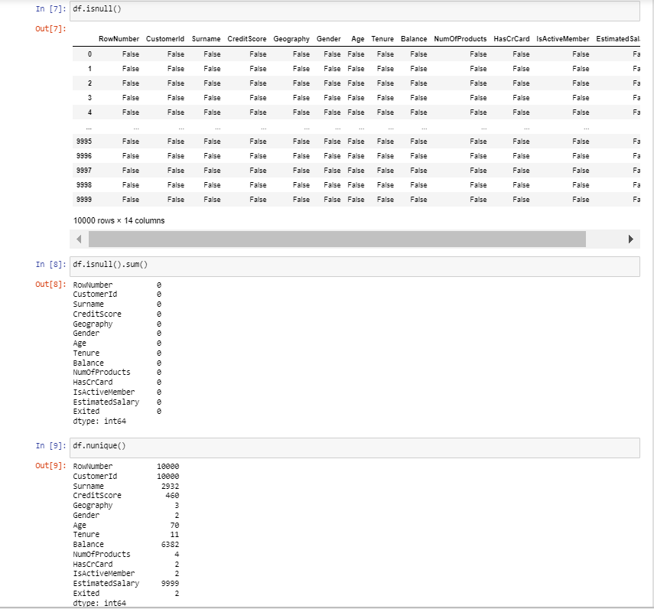
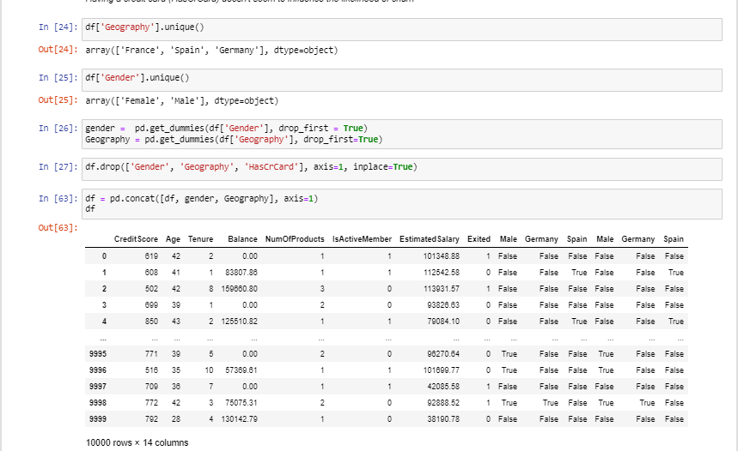
Data Cleaning
While working on the pre-defined datasets, I did data cleaning of my dataset. The dataset consisted of a few unnecessary columns such as Row Number, Customer ID, and Surname which added little value in classifying the customers. These were dropped, as these only added noise to the dataset. It was also checked whether the dataset had any missing values, which it did not have.
The next task was to categorize the numerical and categorical variables. The categorical variables were Geography and Gender, which were both One-Hot-encoded. This data was then passed to the classifier, with the ground truth being the “Exited” attribute and all the remaining columns being the inputs.

Slide 5
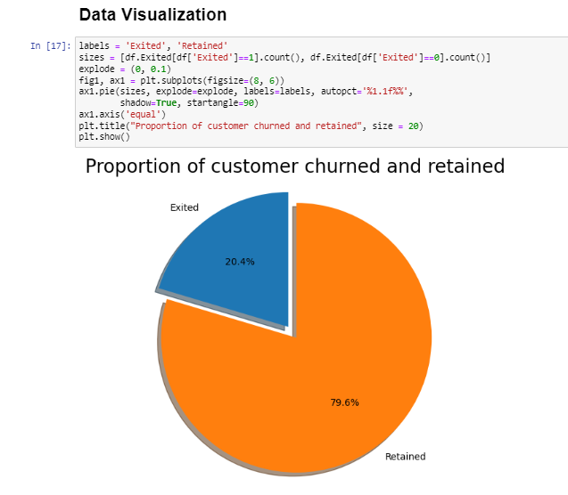
FINDINGS FROM DATA VISUALIZATION
Pie Chart for the Target Variable “Exited”
So about 20% of the customers have churned and around 79% have retained. So the baseline model could be to predict that 20% of the customers will churn. Given 20% is a small number, we need to ensure that the chosen model does predict with great accuracy this 20% as it is of interest to the bank to identify and keep this bunch as opposed to accurately predicting the customers that are retained.

Slide 6
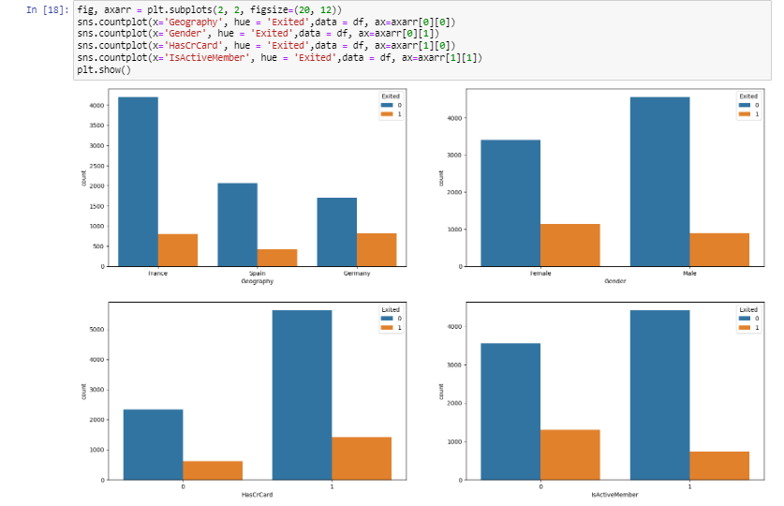
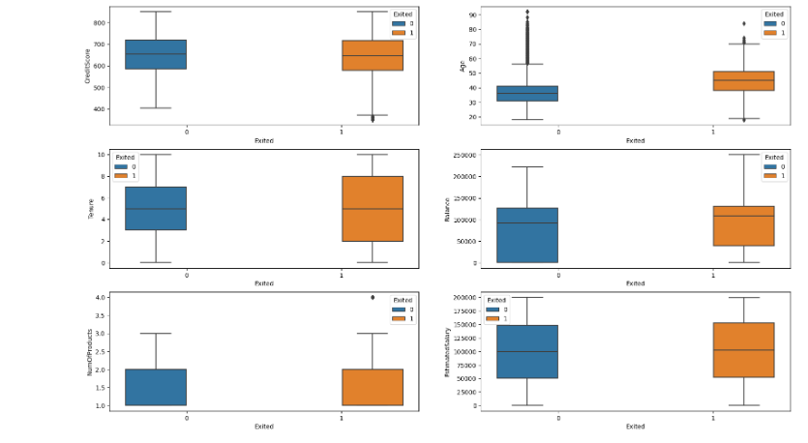
FINDINGS FROM DATA VISUALIZATION
The majority of the data is from persons from France where the majority is towards customers who are retained.
The proportion of female customers churning is also greater than that of male customers.
Interestingly, majority of the customers that churned are those with credit cards. Given that majority of the customers have credit cards could prove this to be just a coincidence.
Unsurprisingly the inactive members have a greater churn. Worryingly is that the overall proportion of inactive members is quite high suggesting that the bank may need a program implemented to turn this group to active customers as this will definitely have a positive impact on the customer churn.
There is no significant difference in the credit score distribution between retained and churned customers.
The older customers are churning at more than the younger ones alluding to a difference in service preference in the age categories. The bank may need to review their target market or review the strategy for retention between the different age groups.
With regard to the tenure, the clients on either extreme end (spent little time with the bank or a lot of time with the bank) are more likely to churn compared to those that are of average tenure.
Worryingly, the bank is losing customers with significant bank balances which is likely to hit their available capital for lending.
Neither the product nor the salary has a significant effect on the likelihood to churn.

Slide 7
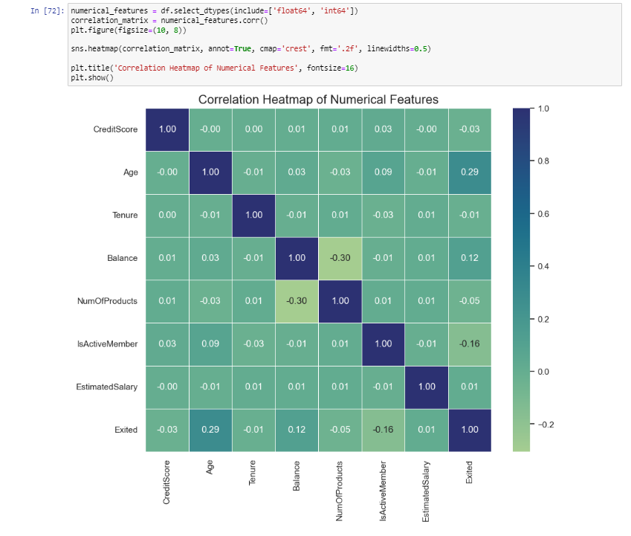
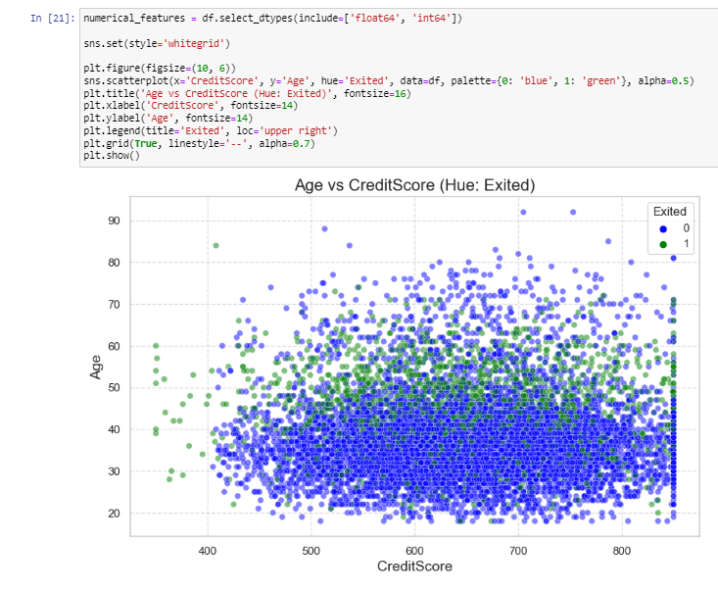
Findings from Data Visualization
Exited" has a positive correlation with "Age" as it has the largest positive correlation value among all columns.
"Exited" has a weaker positive correlation with "Balance" & "EstimatedSalary" columns.
"Exited" has a negative correlation with "IsActiveMember" & "NumofProducts" columns.
"Exited" has no correlation with "Tenure" column.
Insight that can be taken from the scatterplot of CreditScore VS Age with the points color coded by whether customers Exited or not shows that the majority of customers who exited were between 40-60 years old and the majority of customers who does not exited were between 20-50 years old.

Slide 8
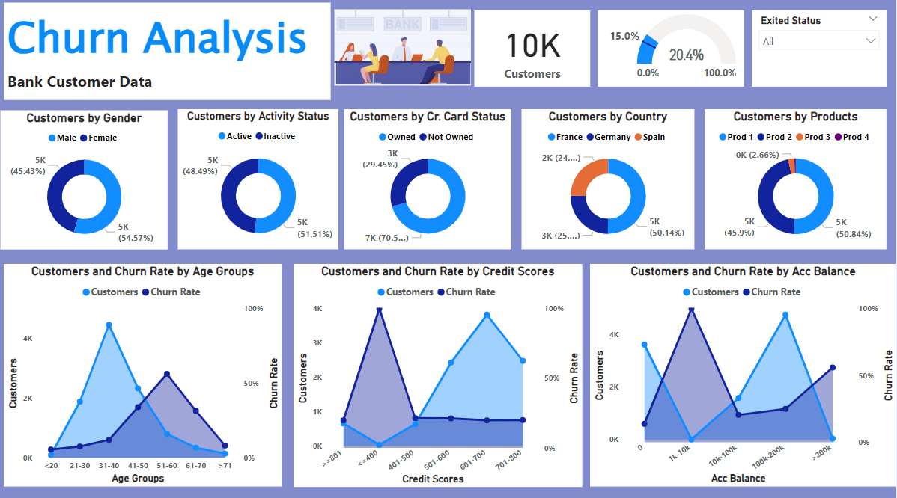
Power BI Dashboard
Here is my Power BI Dashboard for analysis of Customer churn:

Slide 9
Findings from Power BI Dashboard
This board gives us a view of Bank Customer Data graphs and charts for the analysis of whether customers will be churned or retained in a very insightful and interactive way.
The objective of this analysis is to discover various factors contributing to increased customer churn rate at the bank and provide the business users with these insights which they can use to make informed decisions and strategize on how to improve customer retention and reduce churn rate.
The first step was to import the data and then transform the data in the Power Query Editor as it was needed. For transforming the data, I renamed some column names so that they can be much more readable and meaningful For eg: I changed the “Balance” column to “Account Balance”. I removed a few columns which are of no use like the “Estimated Salary” column. Also, to clearly label the data in my “Products” column I changed its values with the help of replace values option. Moreover, I have grouped my 3 columns i.e. Age, Credit Score, and Account Balance individually by using the conditional column function as these columns have a wide range of distinct values. I formatted a few columns to more intuitive data types.

Slide 10
Findings from Power BI Dashboard
I performed a few DAX measures to calculate the Total number of Customers, Churn Rate, etc.
Finally, I have built the report taking into account key factors like account balance, age group, activity status, gender, credit score, etc., and their effects on churn rate. This helped me gain insights into where the bank could make necessary improvements.
The churn rate is very high at 56.2% for middle-aged customers between 51-60 years old.
In terms of those with credit card facilities, the churn rate is highest amongst the lowest credit score group of >400.
Surprisingly, the customers whose account balances are <=200k are the most churned in terms of account balance.
The overall churn rate for male population is 16.5 whereas the overall churn rate for the female population is 25.1%.
For the products, the churn rate is high @ 27.7% amongst customers in the Prod 1 group. The age account and credit score factors are the same here. Similar situation for prod 2 =, however in prod 2, the churn rate is at all times 100% for customers between the 1k-1ok account balance.

Slide 11
Findings from Power BI Dashboard
For customers who own the credit card, for them the churn rate is highest for the 51-60 age groups. The credit score and account balance factors are the same here.
Inactive customers have the highest chance of churning so in the report I created I can see that customers with age groups of 51-60 and 61-70 have the highest churn rate, credit scores less than 400 have the highest churn rate for inactive customers and account balance from 1k-10k has highest churn rate.
In Summary, age group of 51–60, people with low credit scores and those with high account balance (>200k) are most likely to churn. The bank should consider the effective strategies that can address the findings, to better customer retention and reduce chrun rate.

Slide 12
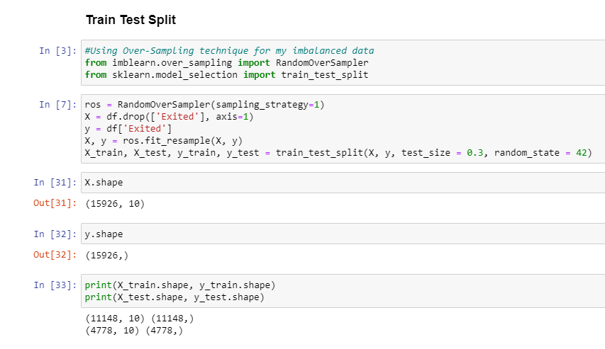
Model Building
After doing Exploratory Data Analysis and Data Visualization, my next step is to do Train Test Split. Here, I used sklearn library to I split my data into train and test. Also, I have an imbalanced dataset so I used the “Over Sampling” technique to balance my dataset. Moreover, I checked the shape of my train and test data.

Slide 13
CLASSIFICATION MODEL: Logistic Regression VS Decision Trees VS RandomForest Classifier VS GradientBoosting Classifier
As the data was dependent on multiple factors or features, so for that, I used 4 algorithms to make a classification report, confusion matrix, and accuracy score to predict my model and to see which classification algorithms among these gave me the best accuracy.
After reviewing the results of the Logistic Regression, Decision Trees, and Gradient Boosting Classifier, it was evident that the dataset could perform better on a classifier that deals with complex attributes and multiple dependencies. This is why the Random Forest Classifier was chosen, and the results showed an improvement.
The test accuracy of the Decision Tree is 90.6%, the Gradient Boosting Classifier is 79.8%, and the Logistic Regression is 64.6% while the Random Forest Classifier had a test accuracy of 93.6%. Test accuracy here refers to the number of correctly predicted labels divided by the total number of labels.

Slide 14
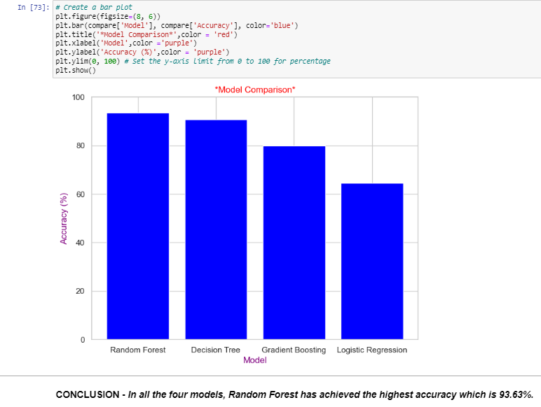
CLASSIFICATION MODEL: Logistic Regression VS Decision Trees VS RandomForest Classifier VS GradientBoosting Classifier
Now we can see that among those 4 algorithms, my comparison is between Decision Tress and Random Forest Classifier.
The F1 score was also calculated to see how well the classifier performed on individual classes. The Decision Tree had an F1-score of 0.90 and 0.91 while the Random Forest Classifier had an F1-score of 0.93 and 0.94.
Thus it was proven that Random Forest Classifiers had an overall better performance.

Slide 15
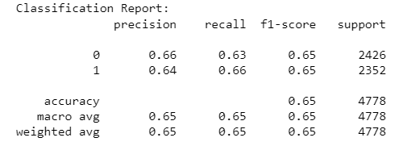
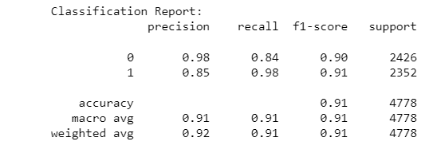
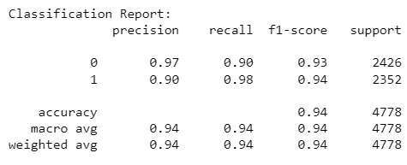
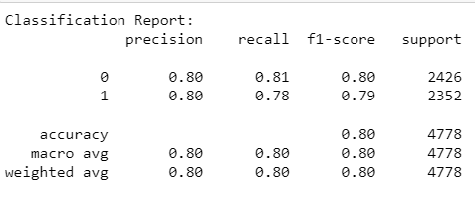
CLASSIFICATION MODEL: Logistic Regression VS Decision Trees VS RandomForest Classifier VS GradientBoosting Classifier
The classification report of all 4 classifiers is as follows:
Logistic Regression
Decision Trees
Random Forest
Gradient Boosting

Slide 16
Results/Conclusions
In conclusion, there are 20.4% of customers who have churned.
By using machine learning algorithms and appropriate evaluation metrics, I have build a model.
With the help of few libraries like – numpy, pandas, matplotlib, seaborn, imblearn, sklearn etc. due to which I was able to train, predict and build my model.
Developed a classifier i.e. Random Forest Classifier that allowed me to predict whether a customer will leave or not with an accuracy of 93.6%. This can help in identifying potentially vulnerable customers who are planning to leave, and we can act in ways to retain them.

Slide 17
Thank You!!

